Slide 1
Holiday Travel Insurance
Ashwin Ravi
Under the Guidance of :
Naganand Shenoy(Business Architect, Areteans)
AVR Satya Prasad(L&D Dept. Head, Areteans)
Gaurav Mathur(Chief Operating Officer, Areteans)

Slide 2
Agenda
Project Description
Technologies Used
Implementation – Explain in detail with snapshots
Best Practices Learned
Conclusion
References

Slide 3
Project Description
Customer and CSR Policy Creation: The application will allow customers to input their insurance details and select from existing plans (Basic, Economy, or Premium). CSRs can also create policies on behalf of customers.
Document Verification and Auto-Rejection: Supporting documents must be submitted for verification, with a mandatory review by a manager within one hour. An auto-rejection rule will apply if the combined cost of tickets and accommodations is below ₹500.
Dynamic Policy Suggestions and Discounts: Future enhancements will include dynamic policy suggestions based on travel specifics (transport mode, distance, number of travellers, and duration). A 10% discount is automatically applied, with additional discounts for first-time users and an option for a recurring discount.
Payment and Cancellation Options: The application will display the total payable amount and detailed policy information. Customers can exit the booking process midway and provide a reason or cancel their policy before the journey start date, with a full refund minus a ₹100 processing fee.
Comprehensive Policy Delivery: Upon completion, a PDF with full policy details, including the validity period aligned with holiday dates, will be sent to the customer.

Slide 4
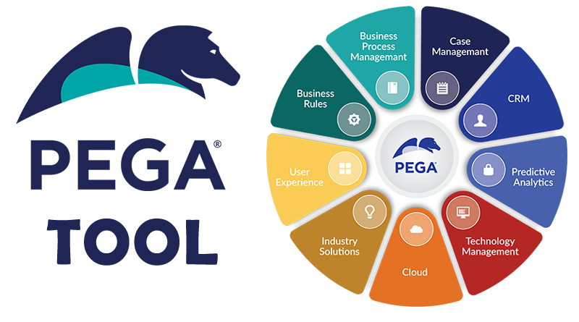
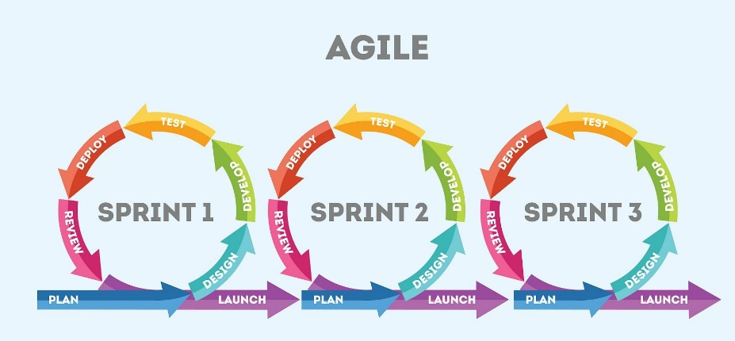

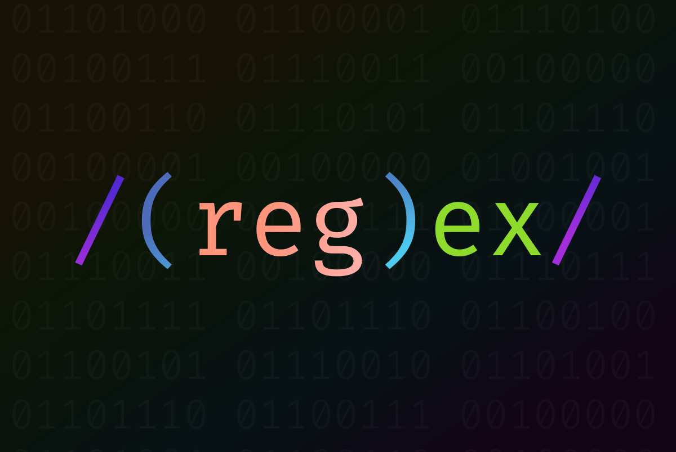
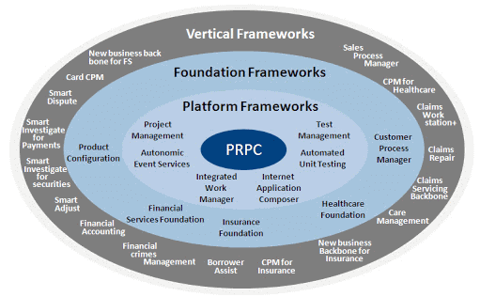

Technologies Used

Slide 5
Implementation
Collect Customer Details
Document Verification
Select Insurance Policy
Review and Confirm Details
Payment Collection
Policy Allotment
Policy Cancellation(at any step of the process)

Slide 6
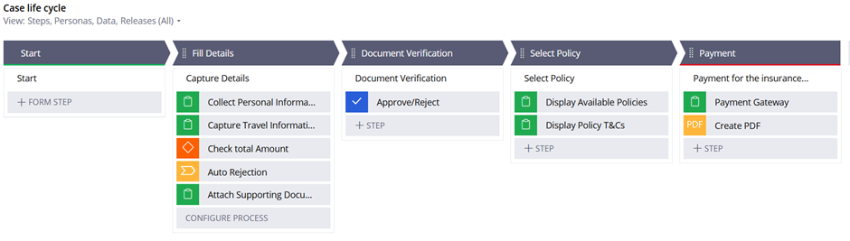
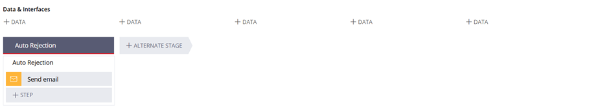
Implementation Snapshots

Slide 7
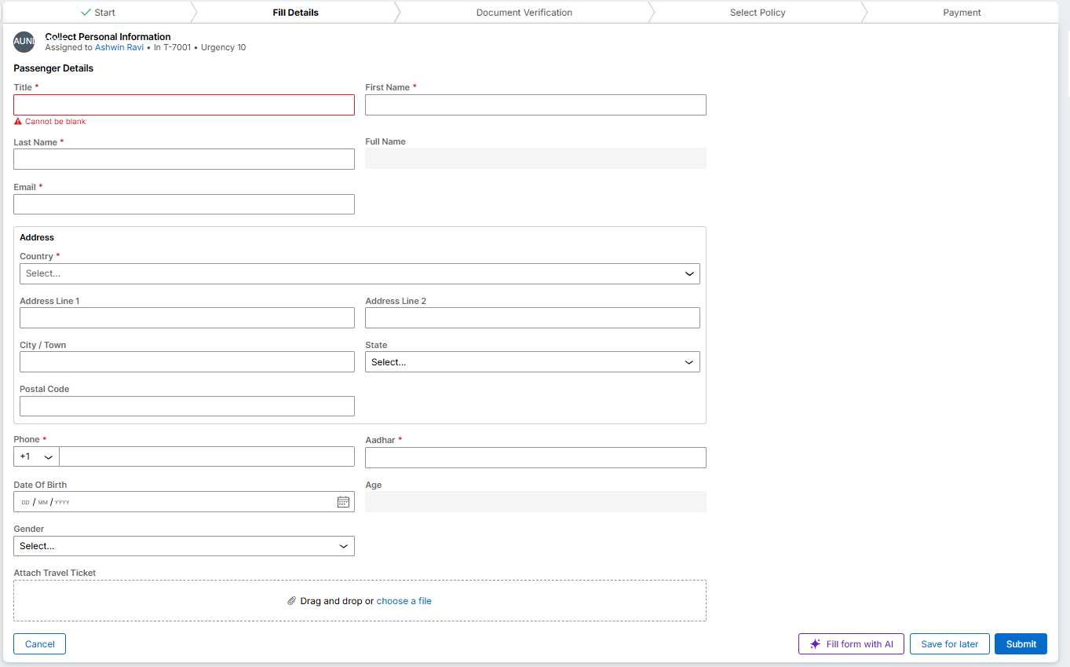
Implementation Snapshots

Slide 8

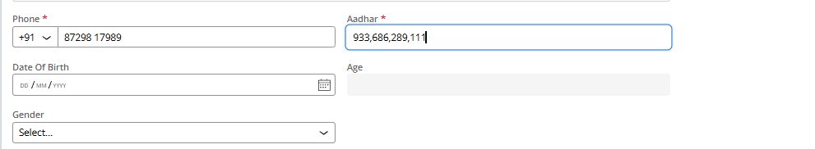
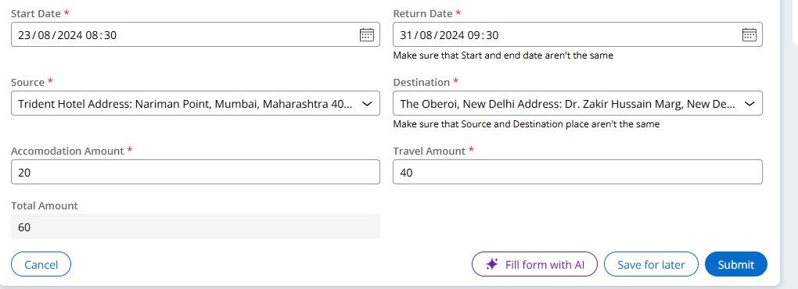
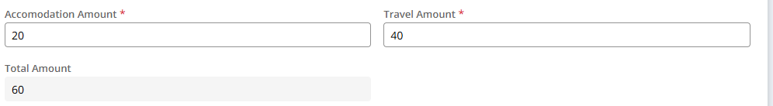
Implementation Snapshots

Slide 9
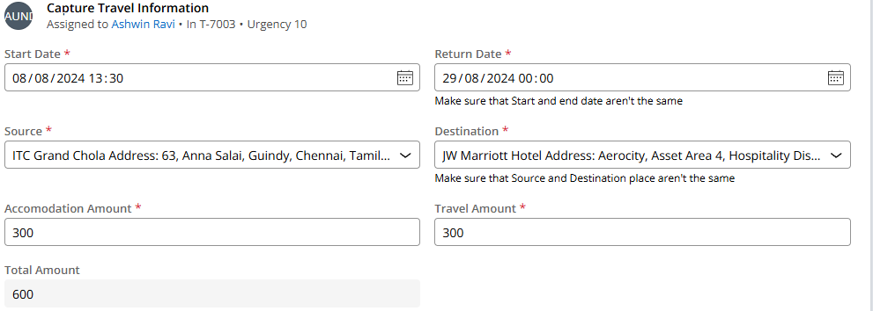
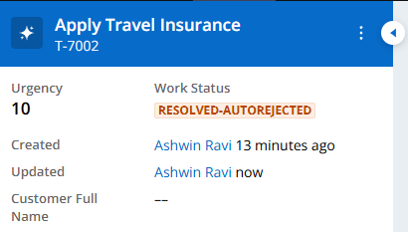
Implementation Snapshots

Slide 10
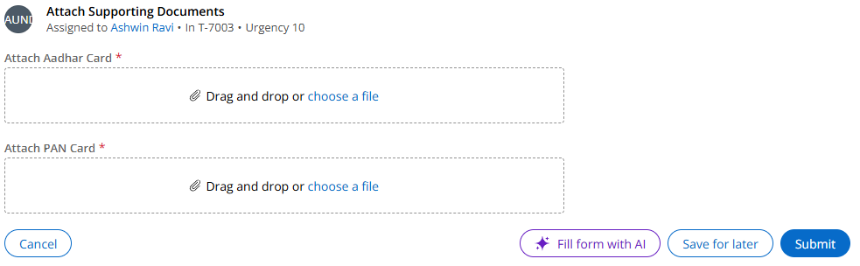
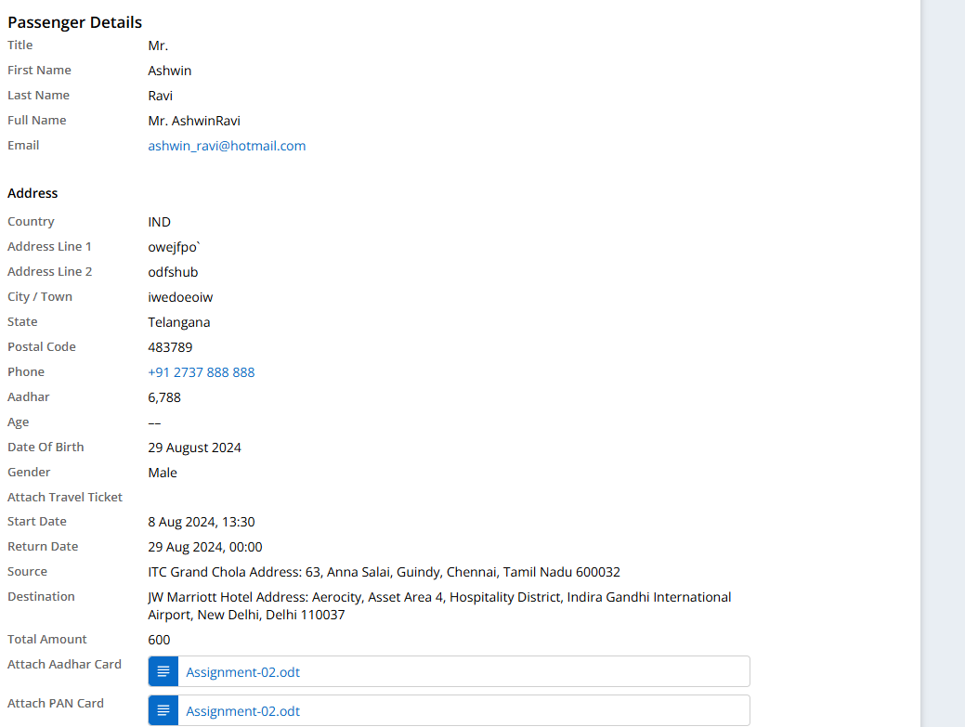
Implementation Snapshots

Slide 11
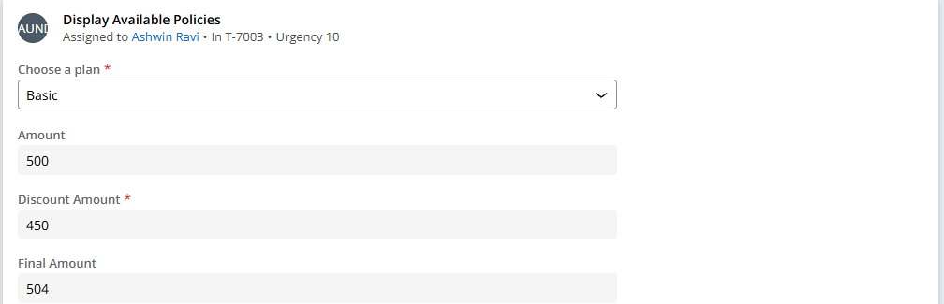
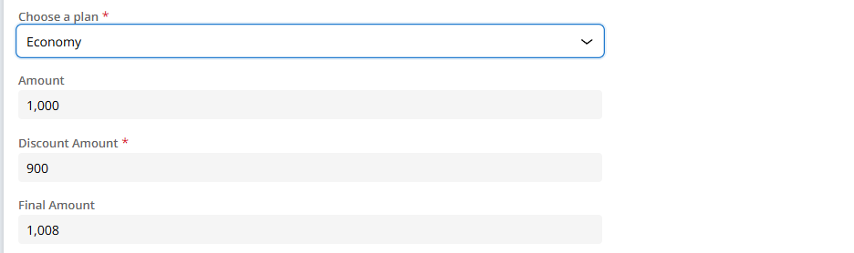
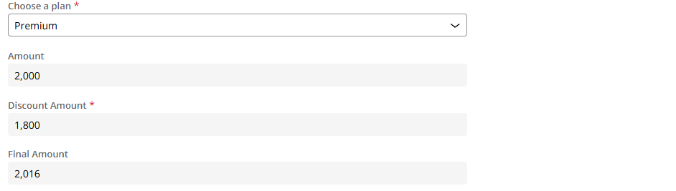
Implementation Snapshots

Slide 12
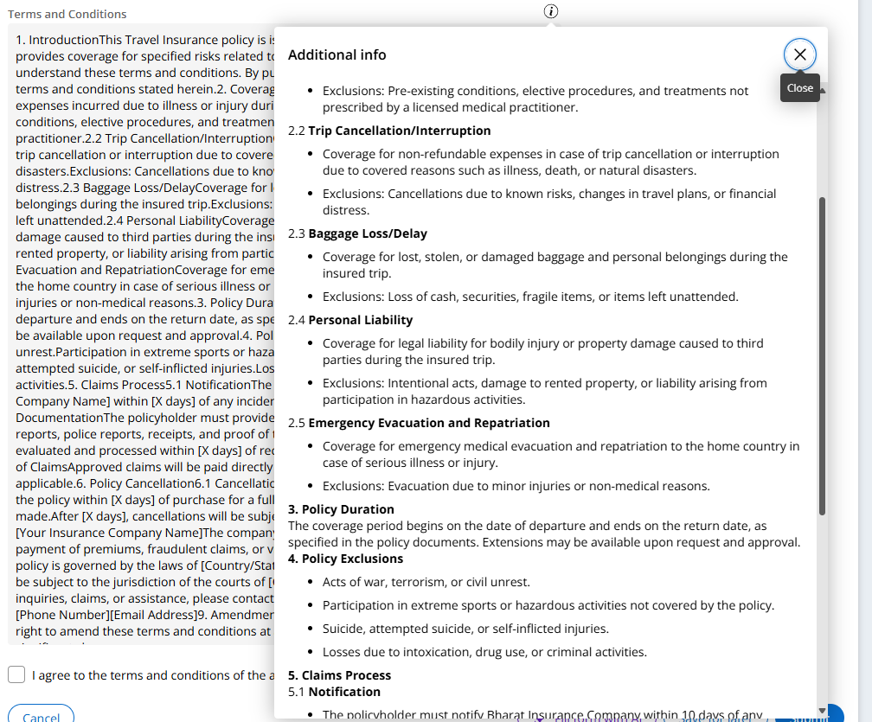
Implementation Snapshots

Slide 13
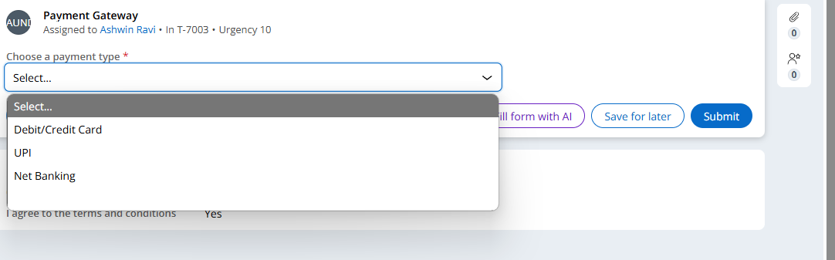
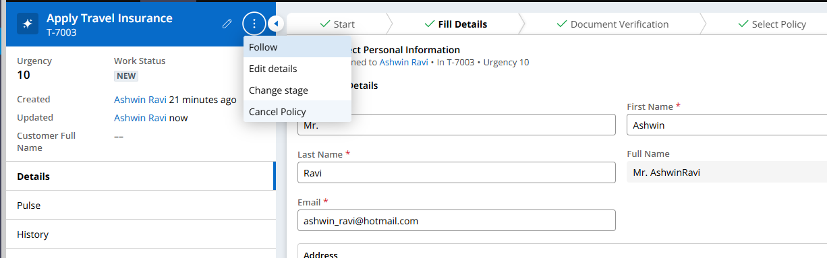
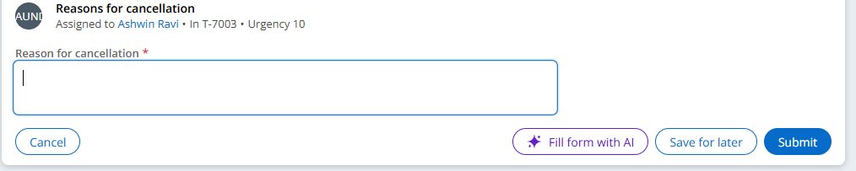
Implementation Snapshots

Slide 14
Best Practices
Identify Business Needs
Consistent and Accessible UI/UX Design
Data Validation and Security
Automated Workflows and SLAs
Centralized Business Rules Management
Agile Development Practices
Role-Based Access Control
Regular Security Audits

Slide 15
Conclusion
Skill Development: Pega Systems, Agile methodologies, Business Logics
Key Takeaways: Problem Solving, Consistent and Accessible UI/UX Design

Slide 16
References
https://academy.pega.com/mission/pega-express-delivery/v1
https://academy.pega.com/mission/low-code-app-builder/v6
https://academy.pega.com/mission/low-code-app-builder-extended/v6
how to calculate age when date of birth is given? | Support Center (pega.com)
https://support.pega.com/support-doc/pdf-document-generation-patterns?
https://support.pega.com/question/paragraph-or-text-block-constellation?
https://support.pega.com/question/how-solve-expected-screenflow-assignment-label-be-create-select-offer-identify-transfer
Calculate Age from Date of Birth in Pega￼￼ - Pega Tech (pegateck.com)

